Slide 1
Redux React: A Journey Through State Management

Slide 2
Introduction
Welcome, everyone! Today, we're going to talk about Redux and its relationship with React. If you're familiar with React, you might have heard about Redux, but what exactly is it? Simply put, Redux is a state management library that can help you manage complex data flows in your applications. It's often used with React, but it can also be used with other frameworks or libraries.
Now, you might be wondering why you should care about Redux. Well, as your applications grow in complexity, managing state can become a real headache. Redux provides a clear and predictable way to manage your application's state, making it easier to reason about and debug. Plus, it can help you write more efficient and maintainable code. So, whether you're a seasoned developer or just starting out, Redux is definitely worth learning!

Slide 3
What is Redux?
Redux is a predictable state container for JavaScript apps. It allows you to manage the state of your application in a centralized location, making it easier to reason about and debug.
At its core, Redux has three main parts: the store, actions, and reducers. The store holds the state of your application, actions are plain JavaScript objects that describe what happened, and reducers specify how the state should change in response to actions. By following these principles, Redux provides a simple and effective way to manage state in your applications.

Slide 4
Why use Redux with React?
Redux provides a centralized store for managing application state, making it easier to manage complex state in React applications.
By using Redux, you can separate your application's presentation logic from its business logic, which can make it easier to test and maintain your code over time.

Slide 5
Redux Principles
Redux is based on three fundamental principles: single source of truth, state is read-only, and changes are made with pure functions.
The first principle, single source of truth, means that the entire state of your application is stored in a single object tree within a single store. This makes it easy to keep track of changes and ensures that there are no inconsistencies in your data. The second principle, state is read-only, means that you cannot modify the state directly. Instead, you must dispatch an action which describes the change you want to make. Finally, changes are made with pure functions, which means that the function takes in an input and returns an output without modifying anything outside of its scope. This makes it easy to test and reason about your code.

Slide 6
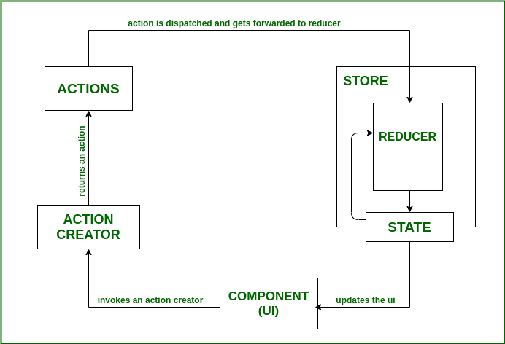
Redux Flow

Slide 7
Redux Flow
Redux store: The Redux store, simply put, is an object that holds the application state. A redux store can consist of small state objects which are combined into one large object. Any component in the application can easily access this state (store) by hooking up to it through the connect method.
Action creators: Action creators, as the name suggests, are functions that return actions (objects). Action creators are invoked when the user interacts with the application through its UI (button click, form submission, etc) or at certain points in a component’s lifecycle (component mounts, component un-mounts, etc).
Actions: Actions are simple objects which conventionally have two properties- type and payload. The type property is usually a string that specifies identifies the action, and the payload is an optional property that contains some data that is required to perform any particular task. The main function of action is to send data from the application to the Redux store.
Reducers: Reducers are pure functions that update the state of the application in response to actions. Reducers take a previous state and an action as the input and return a modified version of the state. Since the state is immutable, a reducer always returns a new state, which is an updated version of the previous state.

Slide 8
The flow of data in a React-Redux application begins at the component level when the user interacts with the application UI. This interaction leads to the action creators dispatching an action.
When an action is dispatched, it is received by the root reducer of the application and is passed on to all the reducers. Thus, it becomes the reducer’s task to determine if it needs to update the state based on the dispatched action.
This is checked by using a simple switch statement to filter out the required actions. Each (smaller) reducer in the application accepts the dispatched action and if the type of the dispatched action matches, it returns a newly updated state.
It is essential to note here that the state never actually changes in redux. Instead, the reducer always generates a new state which is a copy of the old state, but with some modifications.
The store then informs the component about the new state which in turn retrieves the updated state and re-renders the component.
Another important observation here is that flow of data in a React-Redux application is unidirectional, i.e., it only goes in one direction.

Slide 9
Redux Middleware
Middleware in Redux is a way to extend its functionality and add custom behavior to the dispatch process.
For example, middleware can be used to handle asynchronous actions by intercepting them before they reach the reducer and dispatching new actions with the results. It can also modify the dispatch process by adding logging or error handling.
The asynchronous process defines a process that is operated independently with other processes

Slide 10
Redux Thunk acts as a middleware that will return you a function instead of an object while calling through the action creators. The returned function receives the dispatch method from the store and then later it is used to dispatch synchronously inside the body of function once the asynchronous actions have been completed.

